Slide 1
Navigating the Consumer Consciousness
Minh Nguyen Viet Quang

Slide 2

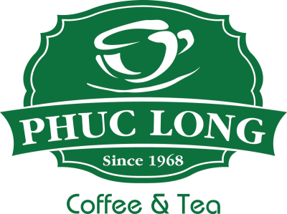



A brief overview of Masan Group…
Masan Group Corporation operates as a holding company, overseeing a diverse portfolio of businesses within its ecosystem. These subsidiaries range from the production and sale of fast-moving consumer goods (FMCGs) and consumer packaged goods (CPGs) to beverages, supermarkets, convenience stores, and banking services.
Recently, Masan has divested from its mineral resource operations under the subsidiary Masan High-Tech Materials, which differs significantly from its traditional focus on the consumer and retail sectors. This strategic shift has caused a slight deviation in financial performance from the growth trajectory previously communicated to investors in annual meetings.
In this presentation, we will focus on what I believe to be the most optimal strategy for Masan to return to its strongest structure and performance. As the founder, Nguyen Dang Quang, once said:
“Mãi mãi tinh thần khởi nghiệp” – “Forever, the startup spirit”
And to quote Andrew Grove, the father of Silicon Valley:
“Only the paranoid survives..”

Slide 3
Making Phuc Long relevant again..
Phuc Long’s current issue is its loss of relevance. Whether due to periods of mismanagement or lackluster innovation, the brand no longer commands the attention it once did. Conversations about Phuc Long are rarely about the exceptional quality of its drinks or the experience it offers. Instead, it’s more about the latest hype or a casual 'Phuc Long is fine,' rather than a passionate 'That was the best f****** tea I’ve ever had,' or 'Starbucks doesn't even f****** compare.' As an investor, this lack of enthusiasm and brand loyalty is concerning.
When we compare Phuc Long to international brands like Luckin Coffee, Arabica, or even local competitors like Katinat, it’s clear they understand that first impressions matter. Every detail—from the storefront and atmosphere to brand management—is meticulously crafted. The drink itself then follows, needing to be executed flawlessly.
Katinat Phu Nhuan
Starbucks Shanghai
Starbucks Kawagoe
Arabica Shanghai
Katinat Cong Hoa
Arabica Shanghai

